Slide 1

BOOST::BEAST
REST API
USING IN C++

Slide 2
Common part
Something about
FOR WHAT
REST API
HTTP Protocols
BEAST
Linking BEAST WITH ASIO CONCLUSION
REFERENCES

Slide 3

Something about
What you need to know to understand boost::beast:
Layered Network Model (ISO/OSI)
ASIO
Network Protocols

Slide 4
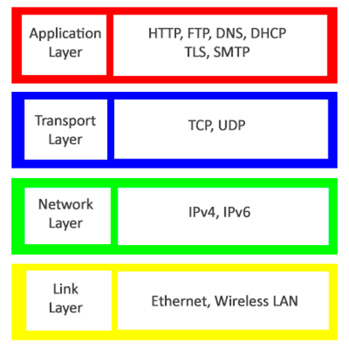
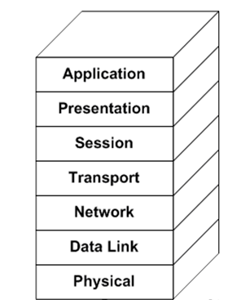
The Internet Protocol Stack Model
Layered Network Model (ISO/OSI)

Slide 5

FOR WHAT?

Slide 6

JG REBOOT

Slide 7
REST API
REST API (Representational State Transfer Application Programming Interface) is an architectural style used to create web services that exchange data with clients over HTTP.
The REST API is used to exchange data between client and server applications using the HTTP protocol.
The REST API relies on the use of standard HTTP methods such as GET, POST, PUT and DELETE to perform operations on resources.
In the REST API, each resource is represented by a unique URL, and client applications can send requests to that address to access the resource.
The REST API uses data formats, such as JSON or XML, to represent resources and transfer data between the client and the server.
The REST API is used in many applications, such as social networks, messengers, online stores, and others, and allows you to create flexible and scalable web services that can exchange data with client applications on different platforms and devices.

Slide 8
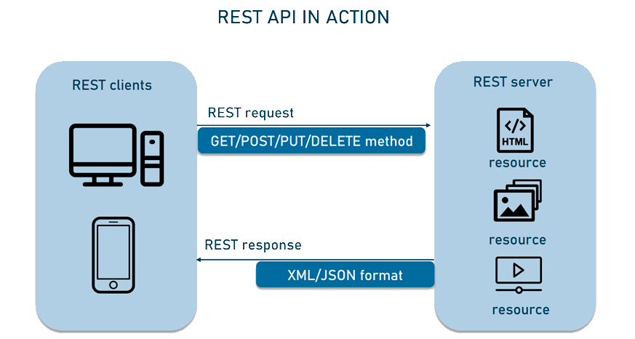
REST API

Slide 9
HTTP PROTOCOLS
(HyperText Transfer Protocol)
Is an application layer protocol used to
transfer data between a client and a server on the Internet.
There are several versions of the HTTP protocol:
HTTP/0.9
HTTP/1.0
HTTP/1.1
HTTP/2
HTTP/3

Slide 10
BEAST
Ease of use
High performance
Multithreading support
Multi-protocol support
Cross-platform
Extensibility

Slide 11
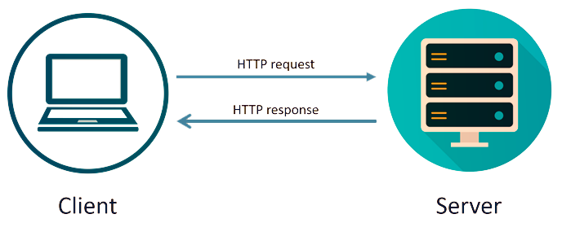
HTTP PROTOCOLS
Beast supports the following versions of the HTTP protocol:
HTTP/1.0
HTTP/1.1
HTTP/2

Slide 12

ASIO
Asynchronous programming model
Multi-threading support
Support of various protocols
Cross-platform
Ease of use
Wide user community

Slide 13

Linking BEAST WITH ASIO
Beast at its core uses Asio to implement the asynchronous I/O needed to handle HTTP and WebSocket protocols. Asio provides mechanisms for asynchronous data reading and writing as well as for managing network connections.
Thanks to asio, it is possible to use SSL to make a secure HTTPS request.
Thus, Beast and Asio are closely related: Beast uses Asio to implement asynchronous I/O, and Asio provides the necessary functions and classes to handle asynchronous I/O in Beast. Using Asio allows Beast to provide high performance and efficiency with HTTP and WebSocket protocols.

Slide 14

Listener

Slide 15

Session

Slide 16

CONCLUSION

Slide 17



REFERENCES

